Slide 1
Welcome to your ESB Oracy Journey!
What is the Level 3 Certificate in Speech (Grade 8)?
The ESB Level 3 Certificate in Speech (Grade 8) will help you to develop your oracy skills and to refine your presentation and performance skills at an advanced level. Specifically, you will construct and deliver original and well-evidenced arguments, interpret and critically review information, and evaluate competing ideas and perspectives in a discussion.
How will it benefit you?
Through this oracy journey, you will develop confident and effective interpersonal and communication skills, which are key for employability, and you can also improve your:
self-esteem
determination
resilience
collaborative working
academic achievement
mental health
empathy
learner agency
confidence
sense of identity
Not to mention that this qualification carries the following UCAS Tariff points for university and HE entry:
24 (Pass, Good Pass);
27 (Merit, Merit Plus); and
30 (Distinction).

Slide 2
Welcome to your ESB Oracy Journey!
“It isn’t just my speaking skills that have improved – it has benefited me in many ways. My writing skills have improved and my essays are now far more in depth.”
What will you actually do in your assessment?
Section One
Research and deliver a 5-minute oral presentation based on a technical subject.
Section Two
Lead a newspaper discussion based on a complex issue with different viewpoints.
Section Three
Provide an evaluative literary recommendation, which involves researching the writer and commenting on their style.
Section Four
Participate in a formal discussion by responding to questions, raising enquiries and offering comments based on the work of others.
“I found as soon as I had a passion for something I wanted to speak about, it actually helped me, it motivated me to do well.”
“I used to see reading a book as a punishment… and now it’s basically a hobby of mine.”

Slide 3
Learning Outcomes and Assessment Criteria
Learning Outcomes The learner will: |  | Assessment Criteria The learner can:
1 | Employ appropriate integrated vocal resources to engage the audience in a performance which shows a sense of ownership. | Perform with a sense of ownership of the material, indicating evidence of research. Consciously integrate knowledge, understanding and skills in a secure and sustained performance.
2 | Respond with authority and mature understanding to the quality, form and content of the material being presented. | Demonstrate an understanding of the material. Demonstrate authority and control thorough relevant preparation.
3 | Adopt and sustain a role and effectively convey complexity of meaning. | Combine skilful and appropriate use of voice and body to engage the audience wholeheartedly. Demonstrate a discriminating and sensitive personal interpretation of the material, which conveys complexity and range of meaning.

Slide 4
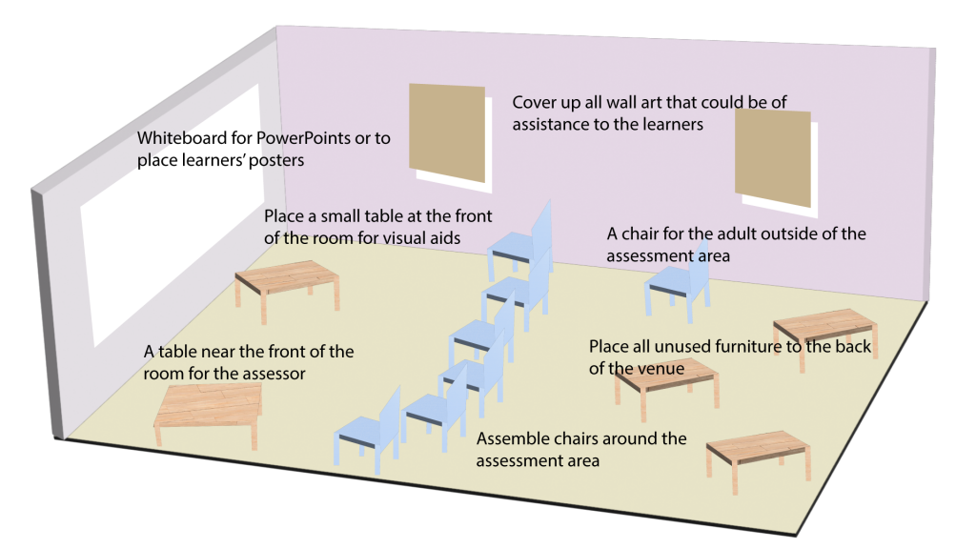
How will you be assessed?
You will present to a minimum group of 5. This permits full interaction for the assessment as a whole.
The assessment group should be seated in a horseshoe with the assessor at one end and the speaker in the mouth of the horseshoe.
This allows for easy eye contact across the group and ensures the assessor is part of the audience.

Slide 5
The Four Sections

Slide 6
Section 1
Research and deliver a 5-minute oral presentation based on a technical subject.
During your preparation and delivery of this section, you will:
You will be assessed on:
Structure and time
Style
Voice and Speech
Content
Use of Supportive material
Communication
Present a topic of substance, using a key investigation/enquiry question to guide research and analysis.
Practise using a range of reputable sources, evaluating and synthesising information.
Begin to use academic discourse, utilising a range of tier 1, 2 and 3 vocabularies, carefully selected to impart their message.
Increase learner agency by taking ownership of your own learning.
Continue developing critical analysis skills: collecting, interpreting and presenting qualitative and quantitative data.
LO1 | Employ appropriate integrated vocal resources to engage the audience in a performance which shows a sense of ownership.
LO2 | Respond with authority and mature understanding to the quality, form and content of the material being presented.

Slide 7
Section 2
You will be assessed on:
Lead a newspaper discussion based on a complex issue with different viewpoints.
Promote engagement in current affairs, develop moral agency and critical thinking.
Learn to adhere to strict time management goals.
Evaluate, synthesise, and analyse information.
Critically evaluate use of evidence and bias in the media, using this knowledge when formulating your own opinions and arguments.
Build leadership skills by guiding and directing discussion, using strategies to include all group members and encourage thoughtful, balanced debate.
Choice and Structure
Introduction
Voice and Speech
Content and Post-discussion Summary
Leading a Discussion
LO1 | Employ appropriate integrated vocal resources to engage the audience in a performance which shows a sense of ownership.
LO2 | Respond with authority and mature understanding to the quality, form and content of the material being presented.
Introduction to ESB (International) Level 3 Certificate in Speech (Grade 8)

Slide 8
Section 3
Provide an evaluative literary recommendation, which involves researching the writer and commenting on their style.
Choice of Material
Evaluation
Memorisation or Reading
Delivery / Voice / Face
Interpretation / Communication
Develop evaluative judgements based in objectivity and a clear understanding of the subject matter.
Opportunity for your personal interests to shine, enabling confident and enthusiastic delivery.
Connect the subject of review to the wider canon, drawing contrasts and comparisons.
Consider own bias and prejudice, giving opportunities for self-reflection and growth.
Explore a range of forms of creative language.
Encourage wider reading, exposing learners to world literature from other cultures and traditions.
Consider historical, political, social, economic, and cultural contexts of pieces of writing.
View literature through a variety of interpretive lenses.
LO3 | Adopt and sustain a role and effectively convey complexity of meaning. | Combine skilful and appropriate use of voice and body to engage the audience wholeheartedly. Demonstrate a discriminating and sensitive personal interpretation of the material, which conveys complexity and range of meaning.

Slide 9
Section 4
Participate in a formal discussion by responding to questions, raising enquiries and offering comments based on the work of others.
Develop higher-order questioning and thinking skills.
Encourage you to be reflective, able to adapt and modify your own views as a result of discussion.
Justify and support your knowledge by preparing for potential areas of enquiry and speaking with conviction and command of your subject.
Autonomy of choice in each section encourages reluctant speakers to feel ownership of their material and gain confidence in their responses.
Response to Questions and Challenges
Questioning
Listening Skills
Taking part in the Group
General

