Slide 1
Section 1 – Research Methods
Lesson Objective: To learn about different types of research and how you can use them for your presentation
Lesson Outcomes:
By the end of these lessons, you should have:
Understood the difference between primary and secondary research
Evaluated the advantages and disadvantages of a range of research methods
Started to plan your own research
Notes:
Collect ideas from the group.

Slide 2
Research Methods
You should have now decided on your presentation topic. So what next? Time to plan your research!
The nature of your research will very much depend on the content of your presentation. In this lesson, we will go through some of the methods you can use to conduct relevant, trustworthy and credible research.
Secondary Research
Primary Research
(Collecting, analysing and using data PPT)
Referencing and avoiding plagiarism

Slide 3
Relevant Grade Descriptors
Section 1: Oral Presentation Time: 5 minutes | Pass | Good Pass (Endorsed) | Merit | Merit Plus (Endorsed) | Distinction
Research and Content | The subject has suitable substance for the level. There is evidence of research. Some conclusions are drawn. | The subject has suitable substance for the level. There is evidence of research. Conclusions are drawn and linked to sources and data. | There is depth of knowledge and consistent use of focused research. Evidence-based conclusions are drawn. | There is depth of knowledge and consistent use of focused research. Well-considered, evidence-based conclusions are drawn. | There is consistent use of focused research which is synthesised to draw conclusions and derive implications based on a range of evidence.

Slide 4
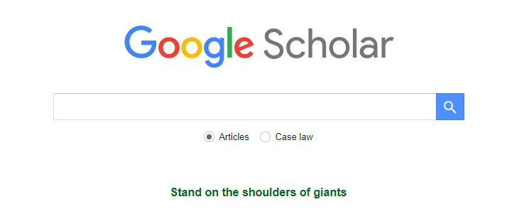
Secondary Research What is Secondary Research?
Secondary research is where you read, collate and analyse existing documents and data.
You can gather this information from a range of sources – we are going to look at some places you can find research:
By using search engines
Online archives
Local and school libraries

Slide 5
Secondary Research Using Search Engines
Google Scholar
Google Scholar is an incredibly useful resource for academic research – it can be used to search for research articles and official documents.
You won’t always be able to access the full article or book in the search results, but it is a great place to start to get some peer-reviewed, academic literature on your topic of choice.
Using an example from the ‘Choosing Your Topic’ PPT, let’s see what our search turns up:

Slide 6
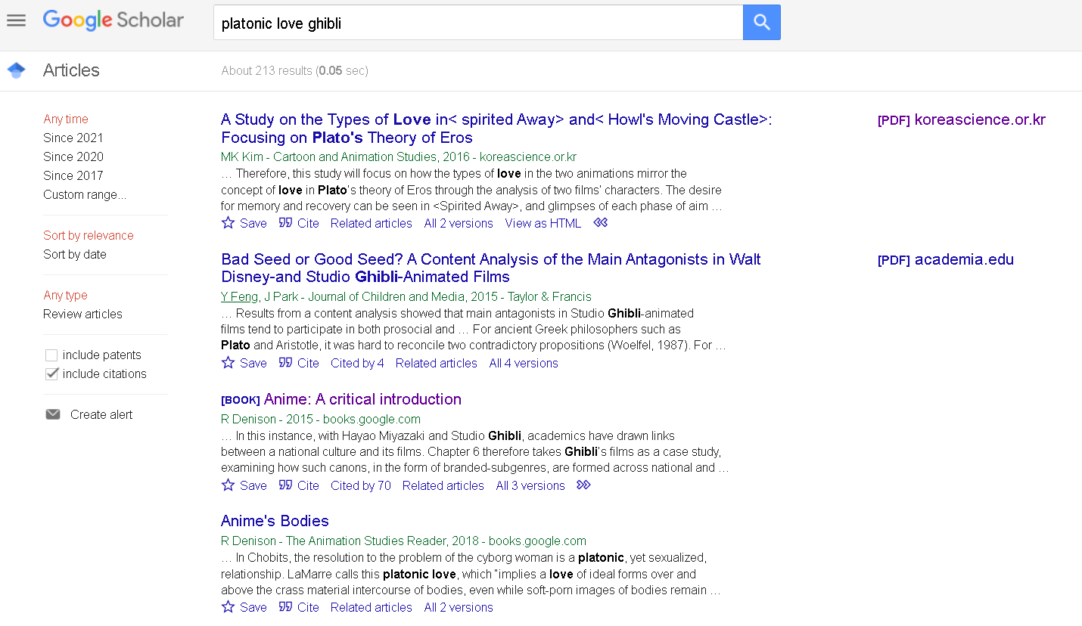
Secondary Research Using Search Engines Google Scholar
Sounds really interesting, but is written in Korean. You can use translate.google.com to upload a pdf (or other document, as long as it is smaller than 10mb) and read a rough transcription.
This means you can access the full PDF.
Not quite what we are looking for, but some results might give you more ideas to develop for your chosen topic.
This is not as specific as the first result, but might be a good overview. Books are often just previews, but you can get some useful information from them.

Slide 7
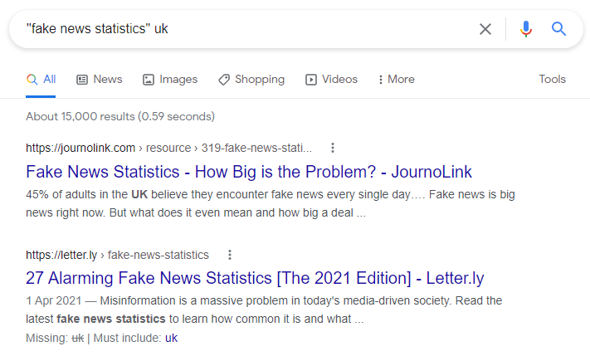
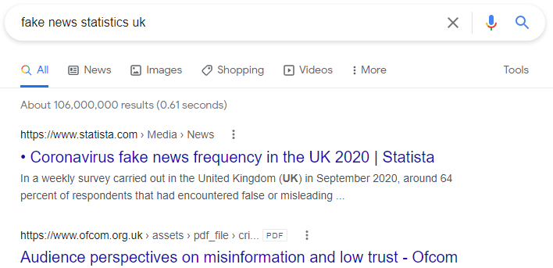
Secondary Research Using Search Engines
Use search parameters to find precise results:
Use “quotation marks” to search for exact words and phrases – can lead to fewer but more precise results.

Slide 8
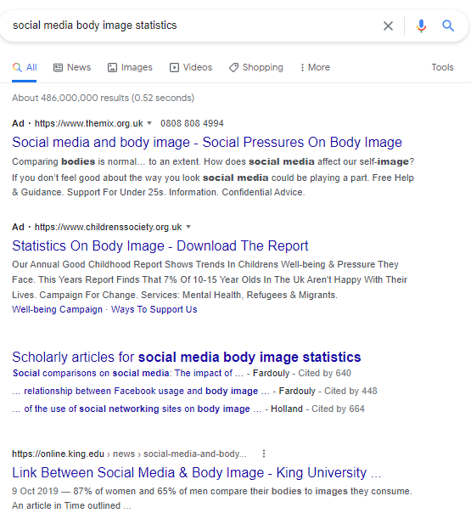
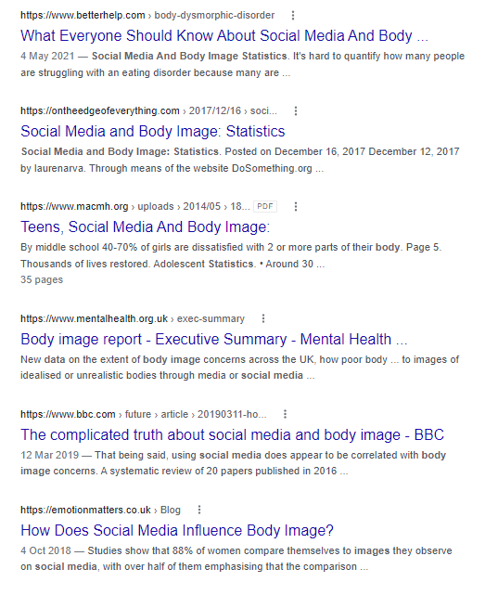
Secondary Research Using Search Engines
Use search parameters to find precise results:
2. Use the asterisk * to search for missing words or letters.
This is a good way for searching for results with multiple word endings, e.g., teen* would return results for ‘teen’, ‘teens’, ‘teenager’, ‘teenagers’.
Particularly helpful when you’re not sure what word you are trying to think of – or if you are trying to cast a wider search net.

Slide 9
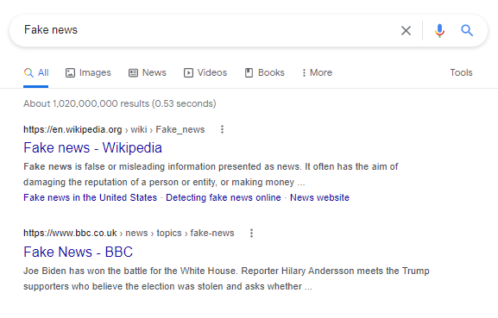
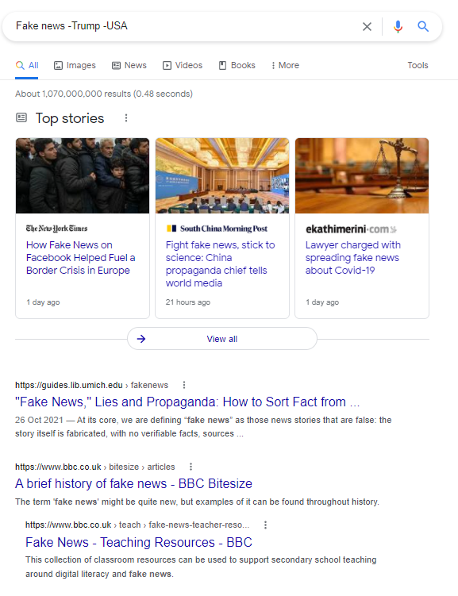
Secondary Research Using Search Engines
Use search parameters to find precise results:
3. Use the minus symbol (-) to exclude terms from your search.
Particularly useful when you want to focus on specific regions, or if there is a person or brand associated with your search term that you want the search to exclude.

Slide 10
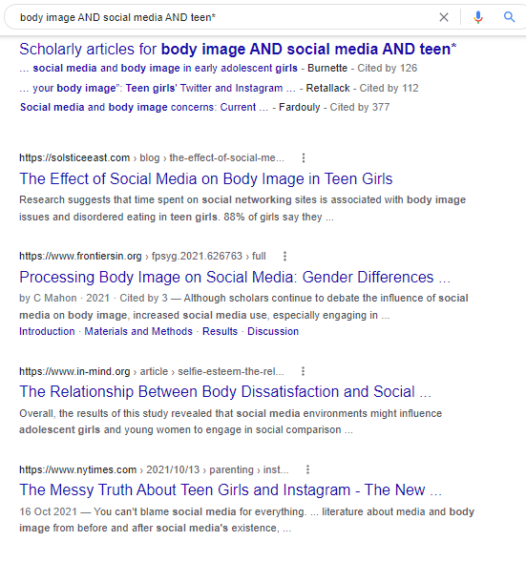
Secondary Research Using Search Engines
Use search parameters to find precise results:
4. Use AND/OR to refine your search further.

Slide 11
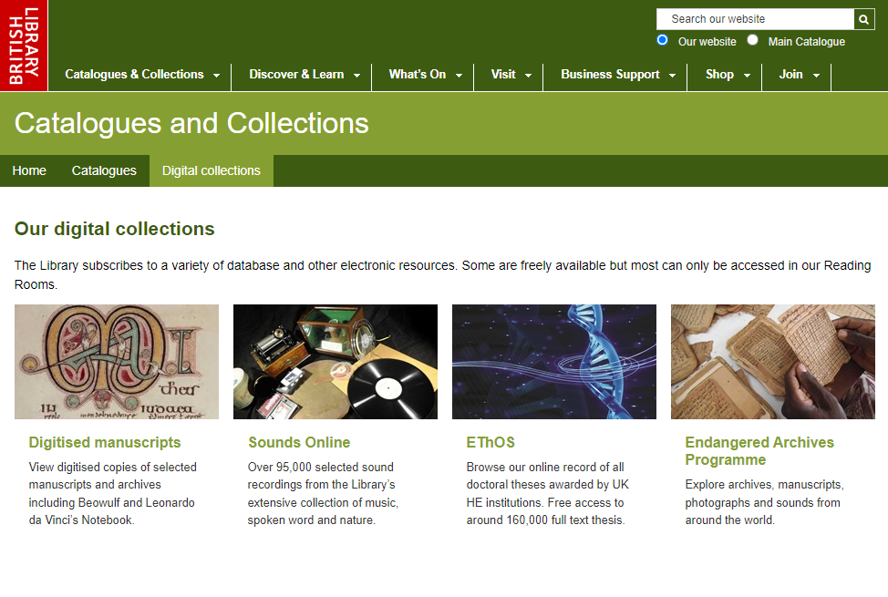
Secondary Research Using online archives
The British Library
The British Library has a fantastic wealth of digital collections – from research on social welfare to manuscripts and photographs, and to a record of all doctoral theses awarded by UK Universities.
It is easy to fall down a rabbit-hole of information, though, so make sure you know what you are looking for!
https://www.bl.uk/catalogues-and-collections/digital-collections

Slide 12
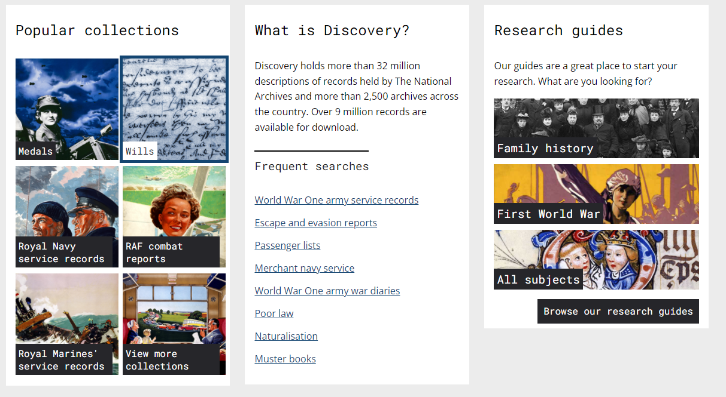
Secondary Research Using online archives
Particularly useful if you are conducting historical research – there are also research guides available to steer you in the right direction.
National Archives UK
https://discovery.nationalarchives.gov.uk/

Slide 13
Secondary Research Using online archives
Other useful websites
Website | Link
A list of online resources provided by University of London – many are available for free online. | https://www.history.ac.uk/library/collections/online-resources
National Library of Scotland | https://www.nls.uk/digital-resources/
An archive of British Cartoons | https://www.cartoons.ac.uk/
A collection of sound files from NASA missions | https://www.nasa.gov/connect/sounds/index.html
An archive of newsreel footage from 1896-1978 | https://www.britishpathe.com/
A collection of historical sound files (e.g. speeches) | http://www.freeinfosociety.com/media_index.php?cat=8&type=3

Slide 14
Secondary Research Local and School Libraries
The internet is not the only place you can conduct your secondary research.
By using the resources in your school and local libraries, you develop your independent learning and problem-solving skills.
Not only that, but you also have direct access to a most valuable resource – the librarian! Many school librarians are trained in study or research skills, and so they can help you with appropriate and reliable research and referencing advice.
Librarians often have an in-depth knowledge of the whole catalogue, so can provide fast and precise results.
If your research is based on your local area, your local library might have useful archives for you to access.

