Slide 1
Section 1 – Engaging your Audience
Lesson Objective: To recognise different ways of engaging your audience
Lesson Outcomes:
By the end of this lesson, you should have:
Practised a range of body and vocal exercises
Used body language and vocal expression to convey different meanings
Identified what makes successful use of supportive media
Self-assessed your skills
Notes:
Collect ideas from the group.

Slide 2
Engaging your Audience
You have researched your topic in incredible depth, pulling together primary and secondary sources, conducting your own surveys and reviewing existing literature.
You have laboured over the structure of your talk and planned in your rhetorical devices and signposting.
What is the last part of the puzzle to making your talk a resounding success?

Slide 3
So how do we keep our audience engaged and on board?
In your pairs/groups, note down any methods you can think of to keep engagement high. You might consider:
Style, use of notes, use of supportive material, voice, body language, gesture, language…
Be prepared to share your ideas!
ENGAGEMENT

Slide 4
Relevant Grade Descriptors
Section 1: Oral Presentation Time: 5 minutes | Pass | Good Pass (Endorsed) | Merit | Merit Plus (Endorsed) | Distinction
Style | There is over-reliance on notes or a memorised script. | Notes are used for support with occasional over-reliance. | Notes are used efficiently. | Notes are used efficiently and naturally. | Notes are used subtly, with complete command of the material.
Voice and Speech | Speech clear and audible, controls pace. | Speech clear and audible, with some variety of pace used for effect. | Voice has some vitality. Uses varied pace and pause. | Voice has vitality. Variety of pace and use of pause used for good effect. Delivery fairly fluent. | Self-assured, fluent delivery.
Communication | Shows some awareness of audience and occasion. | Shows good awareness of audience and occasion. | Appropriate register. Involves listeners to share interest. | Appropriate and assured use of language engages listeners. | Confident and assured, shares views with authority, apt and mature use of language.

Slide 5
Style
Notes:
Direct link to videos:
https://youtu.be/idRlVDudpfo
If video appears as a black box, play the PPT as a slideshow and wait a few seconds for it to load.

Slide 6
Using voice and body language to engage
Body Language Exercises
Body movement
Gestures
Head position
Eye contact/movement
If you haven’t already, try writing the introduction of your presentation.
Once you have this, in pairs or groups, practise giving your introduction.
Use the ‘Body Language Pick-and-Mix’ examples to change the way you deliver your opening.
Discuss together which methods were effective and which weren’t, and why this was the case.
Consider how your body language creates meaning – maybe unintentionally so.
Confident
Assured
Mature
Prepared

Slide 7
Body Language Pick-and-Mix
 | 1 | 2 | 3 | 4
A | Move backwards as you give your introduction | Hold your hands behind your back as you talk | Have your head tilted to the side for your introduction | Maintain constant eye contact with one member of the audience
B | Move forwards as you give your introduction | Hold your hands clasped together in front of you as you talk | Read from your notes without lifting your head | Look at each person in turn, one by one, intently
C | Stay very still as you give your introduction | Hold your hands in a natural, open position as you talk | Shake your head for positive sentences and nod for negative sentences | Allow your gaze to naturally move from your notes to your audience
D | Pace from side to side as you give your introduction | Use functional gestures as you talk to match your tone/words (pointing, thumbs up/down, raise hands for increase, lower for decrease) | Use your head movements to reinforce your ideas – nod when you are positive, lift your head to show you are thoughtful etc. | Dart your eyes from your notes to the door as you speak.
Notes:
You could use this grid in a number of ways – you can choose your own selection and play a game of Body Language Bingo; you could roll dice to determine which methods to use; you could discuss which will be effective and which won’t for your own talk and try to employ the best ones.
If the methods are contradictory, you could do each one in turn whilst you talk (e.g. every two sentences).

Slide 8
Using voice and body language to engage
Vocal Exercises
Pace
Pause
Intonation
In the same style, repeat this exercise with your vocal pick-and-mix methods.
You might want to re-work your openings before you continue or change groups for variety.
Use the ‘Vocal Pick-and-Mix’ examples to change the way you deliver your opening.
Discuss together which methods were effective and which weren’t, and why this was the case.
Consider how your vocal expression creates meaning – maybe unintentionally so.
Voice has vitality
Fluent
Engaging
Effective

Slide 9
Vocal Pick-and-Mix
 | 1 | 2 | 3
A | Deliver your opening as quickly as possible | Choose one appropriate moment to use a pause – where will it create the most impact for your audience? | Choose one word or phrase to emphasise by shouting it very loudly
B | Deliver your opening as slowly as possible | Use an exaggeratedly long pause. | Choose one or two words or phrases to emphasise (through pause, volume, pitch – which ever is appropriate)
C | Try to deliver your opening as naturally as possible | Pause in between every sentence. | Emphasise at least one word in every sentence
D | Plan in one part of your opening to either increase or decrease the pace to create impact | Do not pause – at all. | Deliver your opening in a perfect monotone

Slide 10
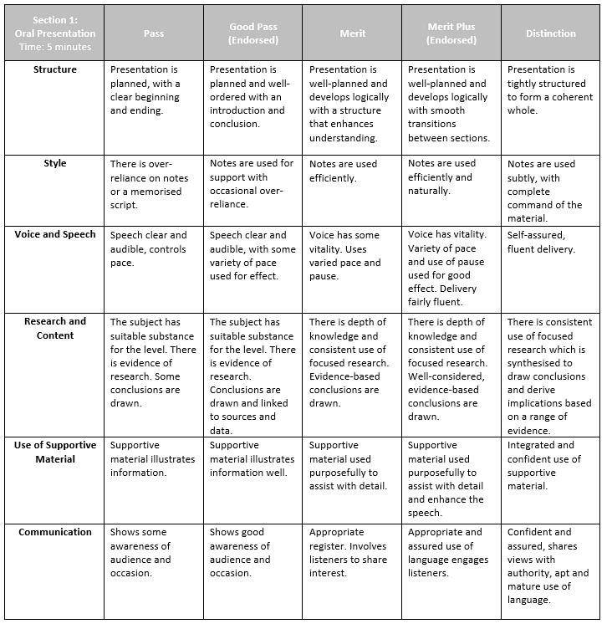
Section 1: Presentation
Watch the video example of a Level 3 Grade 8 Presentation.
Use the Grade Descriptors to assess how you think this learner did.
You might want to highlight where you think they have met the grade descriptors.
List 3 things that the learner did especially well:
What could the learner do to improve next time?
Notes:
Highlight the grade you feel this learner is working at; give a target for improvement.

Slide 11
Level 3 Grade 8 Presentation.
Use the Grade Descriptors to assess how you think this learner did.
You might want to highlight where you think they have met the grade descriptors.
Notes:
Direct link to video:
https://youtu.be/pmSLOnQaWzw
If video appears as a black box, play the PPT as a slideshow and wait a few seconds for it to load.

Slide 12
Level 3 Grade 8 Presentation – Questions and Answers
Now watch how the learner responds to questions from their peers.
Use the Grade Descriptors to assess how you think this learner did.
You might want to highlight where you think they have met the grade descriptors.
Notes:
Direct link to video:
https://youtu.be/DiDvoNfln0c
If video appears as a black box, play the PPT as a slideshow and wait a few seconds for it to load.

Slide 13
Use the Grade Descriptors to assess how you think this learner did in their presentation and in their questioning.
You might want to highlight where you think they have met the grade descriptors.
Notes:
Direct link to video:
https://youtu.be/JMBCl3l5tks
If video appears as a black box, play the PPT as a slideshow and wait a few seconds for it to load.

