Slide 1
Section 2: Style, Bias and Viewpoints
Lesson Objective: To identify and discuss style, bias and viewpoints in a news item
Lesson Outcomes:
By the end of this lesson, you should have:
Identified different styles and their effects
Explained what bias is and identified examples from a news item
Analysed the issues, viewpoints and perspectives in a news item
Started to analyse your own choice of news item

Slide 2
Relevant Grade Descriptors
Section 2 Discussion of a News Item Time: 3+6+1 minutes | Pass | Good Pass (Endorsed) | Merit | Merit Plus (Endorsed) | Distinction
Summary of an article | Outlines article and key issues. | Outlines article, key issues and style or bias. | Summarises article, key issues, and style or bias. | Analyses article, key issues, style and bias. | Succinct, insightful summary, analysis and evaluation of article.
Content and Post-Discussion Summary | Some evidence of prior research. Brief statement of views expressed during discussion. | Evidence of prior research. Considered statement of views expressed during discussion. | Clear evidence of additional research. Summarises debate and draws conclusions. | Clear evidence of additional research. Summarises debate with a considered statement of views and draws conclusions. | Thoroughly and selectively researched. Concise perceptive analysis, with reference to main contributions.

Slide 3
3-6-1
Your newspaper discussion will follow this format:
1 minute | Provide an introductory summary of the article. Identify issues and offer analysis and evaluation of the reporting (style, bias, viewpoints/attitudes)
6 minutes | Lead a discussion
1 minute | Summarise and conclude the discussion
This series of activities is designed to guide you through some preparations for each of these segments.
You might not use all of the resources here, but they are there to support your planning if you need them!

Slide 4
1 minute – introduce and summarise
Useful Tasks:
Track through your article and summarise each paragraph in as few words as possible.
Track the key issues raised by your article.
Highlight any interesting examples of style and language use.
With a partner, practise introducing and summarising your article
Give each other constructive feedback based on the grading criteria

Slide 5
Styles of Writing
Can you name any features of these writing styles?
persuasive
narrative
descriptive
expository
sensationalist

Slide 6
Styles of Writing
How does the style of the writing impact the news story you are presenting?
Clear opinion/viewpoint
Rhetorical devices
persuasive
descriptive/narrative
Aims to shock
expository
sensationalist
Short, snappy headlines – alliteration, puns
emotive

Slide 7
What is Bias?
Essential Meaning of bias
1: a tendency to believe that some people, ideas, etc., are better than others that usually results in treating some people unfairly.
(Merriam Webster)
What types of bias are there?
How might they affect a news item?
Discuss together and be ready to share your ideas.
Some examples you might choose to look at:
Political Bias
Decline Bias
Implicit/Cultural Bias
Hindsight Bias
Notes:
You might give your group time to research types of bias before this lesson, or during the lesson (or after it!) to support their discussions.

Slide 8
How do we identify bias?
Great links:
AllSlides
NewseumEd
Masterclass
Media Bias/Factcheck
Identifying bias is an important part of being media literate.
This will help you in turn to be politically literate and to use critical thinking to interpret what you read, hear and watch.
When you are reading/viewing/listening to a news item or media source, here are some questions you could consider:
What do I know about the source? E.g. Who are they; when is the information being relayed; why are they writing?
Is there a range of viewpoints or just one?
What evidence is provided to support the claims (and what are the sources of these)?
What are other media outlets saying about the same story?
Who is the audience?
Notes:
If you search for a news source in Media Bias/Factcheck, it will give you lots of information about the political bias and reliability of sources etc.

Slide 9
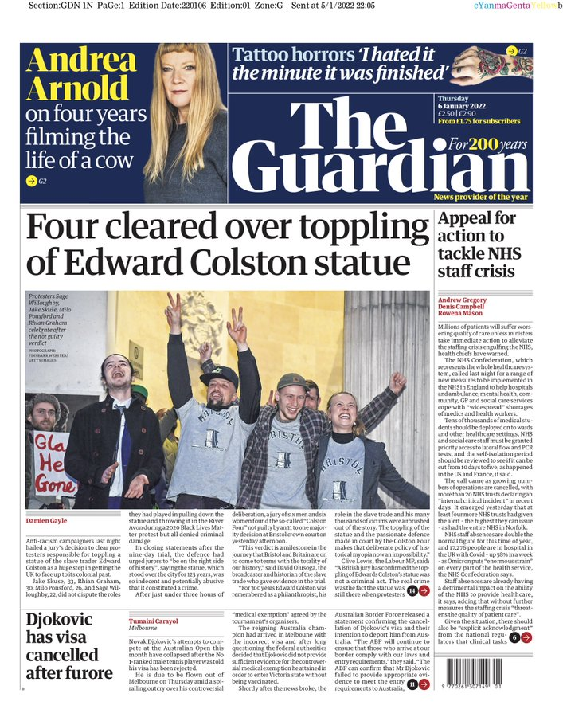
Example Activity
Read openings of these two articles:
Working in pairs or small groups, read an article each (you might want to follow the links to find the full articles online).
Fill in the worksheet in your workbook, analysing the style, bias and viewpoints shown.
Notes:
https://twitter.com/guardian/status/1478857625509023751?s=20&t=fqZt5le6v6JUH34hx1HzkA
https://twitter.com/DailyMailUK/status/1478858088291651584?s=20&t=56qMqUCjB61RwV3ZR5qg1A

Slide 10
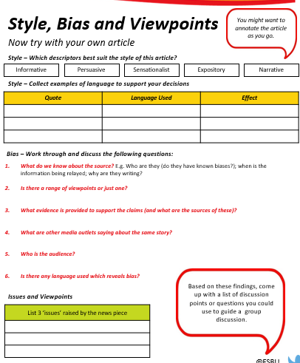
Identify issues and offer opinions about the reporting (style, bias, viewpoints/attitudes)
Using the information and skills developed through these activities (as well as any other brilliant ideas of your own) plan and practise the middle segment of your news discussion.

