Slide 1
Section 3: Giving a reading - vocal expression and body language revisited
Lesson Objective: To select a reading and explore ways to convey its meaning to the audience through vocal expression and body language.
Lesson Outcomes:
By the end of this section, you should have:
Identified a suitable section of text to read
Practised a range of vocal and body exercises to enhance your reading

Slide 2
Relevant Grade Descriptors
Section 3: Literary Recommendation Time: 4 minutes | Pass | Good Pass (Endorsed) | Merit | Merit Plus (Endorsed) | Distinction
Reading | A degree of familiarity with text but needs constant reference. | Clear familiarity with text but needs frequent reference. | Confidently spoken, with regular text support. | Confidently spoken, with some text support. | There is subtle reference to text.
Delivery/Voice/ Face | Voice audible and clear, using vocal and facial expression. | Voice audible and clear, appropriate phrasing. | Appropriate phrasing, pace and pause. | Appropriate phrasing, good use of pace and pause. | Free and fluent delivery.
Interpretation/ Communication | Concentrates on the metre or structure. | Conveys the meaning of the text well. | Creates and conveys mood. | Creates and conveys mood with good audience awareness. | Sense of spontaneity with sensitivity to text and audience.

Slide 3
Familiarisation Techniques
Reading | A degree of familiarity with text but needs constant reference. | Clear familiarity with text but needs frequent reference. | Confidently spoken, with regular text support. | Confidently spoken, with some text support. | There is subtle reference to text.
The first, and most important task is to understand the piece. Check any words you’re not sure of, in terms of sense or pronunciation, and read and re-read the piece – several times - until you’re satisfied that you have internalised the meaning. Now you can begin to learn it.
We understand that fully memorising a piece of writing at this level can be challenging. Therefore, we have updated our qualification to emphasise familiarity with the text instead. While full memorisation is not required, developing a deep familiarity allows you to focus on delivering the piece with varied pace, pitch, and tone. By becoming so comfortable with the text that you only need it for occasional reference, you can bring your own unique interpretation to life and truly captivate your audience.
With this in mind, we have some familiarisation techniques on the following slides to help you:
Notes:
Taken from ESB’s guide to memorisation for Level 2 Certificate in Speech – Grade 4 (Perform).

Slide 4
Top tips for familiarisation:
1
Taking the piece one line at a time, speak each line six times, before adding the next line and repeating the extended section six times. Using the example of the poem The Horses by Ted Hughes: I climbed through woods in the hour-before-dawn dark.(repeat X6) I climbed through woods in the hour-before-dawn dark. Evil air, a frost-making stillness,(repeat X6) I climbed through woods in the hour-before-dawn dark. Evil air, a frost-making stillness, Not a leaf, not a bird (repeat X6)
2
Read the piece through a number of times. After, turn the paper over, and see how much of it you can accurately write out before you have to remind yourself of the words. Each time you have to check the words, start writing the piece out from the beginning again. This can also be used with reciting the words out loud or typing the words out.

Slide 5
Top tips for familiarisation:
3
Make an audio recording of yourself accurately reading the piece with expression and pause. Copy the piece to an audio file and replay the piece through headphones, speaking the words along with the file. Go back to the beginning each time you make an error.
5
‘Storyboarding’ your piece. Draw up a grid and take the piece in chunks, drawing pictures of each element, with the words above it. On the next slide is an example (made using ‘Storyboard That’), Medusa by Louise Bogan. When you have finished your storyboard, try delivering it (or acting it out) in front of friends and family as a way to establish it in your memory. The more you practise, the more you will remember!
4
Make an audio recording of yourself accurately reading the piece with expression and pause. Copy the file multiple times and listen to the audio at every opportunity – even when you go to sleep!
There is no one perfect method for familiarisation – you might want to use a combination of these and other methods to suit you and your type of text.
Use the page in your workbook to keep track of the methods you’ve tried and how well it works for you. You might discover new revision tools to use.

Slide 6
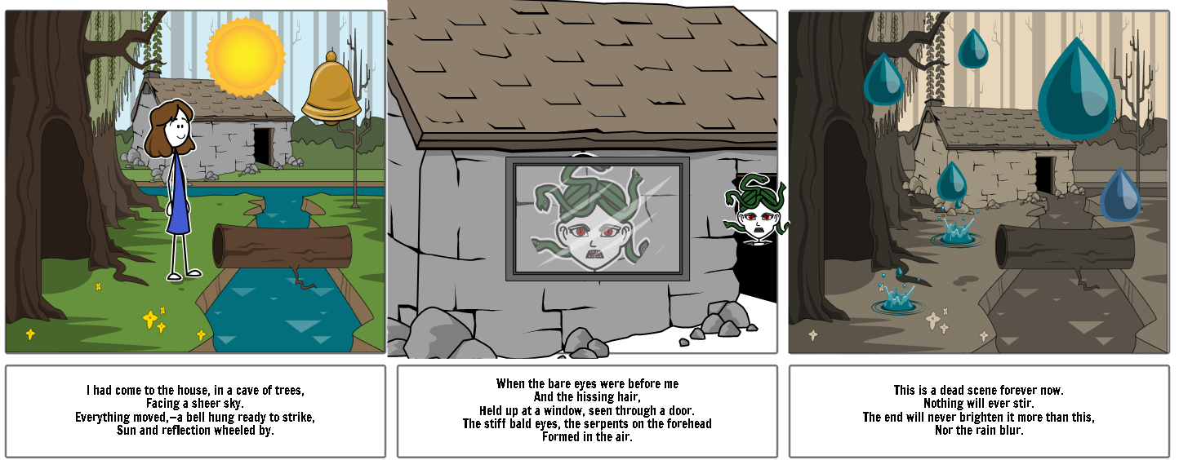
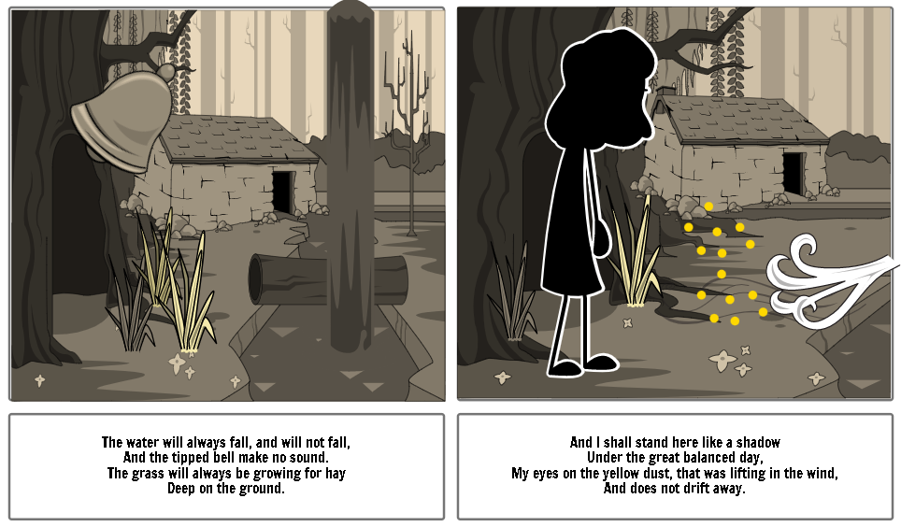
Remember: you don’t have to memorise every word, especially if you are recommending a novel – but you should know the text well enough to be able to fully and freely communicate its meaning without being hindered by looking at the page.
Notes:
Storyboard created via storyboardthat.com

Slide 7
Pace, Pause, and Expression to Create Mood and Meaning
Section 3: Literary Recommendation Time: 4 minutes | Pass | Good Pass (Endorsed) | Merit | Merit Plus (Endorsed) | Distinction
Delivery/Voice/ Face | Voice audible and clear, using vocal and facial expression. | Voice audible and clear, appropriate phrasing. | Appropriate phrasing, pace and pause. | Appropriate phrasing, good use of pace and pause. | Free and fluent delivery.
Interpretation/ Communication | Concentrates on the metre or structure. | Conveys the meaning of the text well. | Creates and conveys mood. | Creates and conveys mood with good audience awareness. | Sense of spontaneity with sensitivity to text and audience.

Slide 8
Pace, Pause and Expression: Creating Mood and Meaning
Use the peer assessment activity to give each another constructive criticism.
You can work together to support one another.
One of the most important things to remember is:
Do not rush.
Nerves and adrenaline can cause you to rush through your recommendation, so make sure you practise the pace of your reading. Some ways that you can work on this as you are learning and developing your reading/recitation are:
Sing the words (to the tune of a nursery rhyme, a song by a favourite artist, a classical piece) – by singing, you automatically lengthen vowel sounds, which slows the pace. Then, speak your piece and see if it helps you to control the pace.
Complete a lap to the first line – of the classroom, of your bedroom/hallway, around a group of chairs (whichever suits). Try to make your first line (obviously, dependant on the text) last the duration of your lap.
Make the punctuation physical – choose an action to perform for pieces of punctuation e.g. do a squat for a comma, turn 360° for a full stop.
On a copy of your text, you could:
Explore the rhythm, metre and/or stresses of the text. Add underline, highlight, or bold to words/syllables you want to stress. For poetry, consider the metre it is written in – is it iambic pentameter, for example?
Similarly, experiment with pauses – where do you want to pause for dramatic effect? Why? For how long?
Are there any words you want to be quieter or louder?
Is there dialogue? How are you going to differentiate between dialogue and narration?
Annotate your text with the emotions/moods you want to convey to your audience – then think about how you can create them with your voice, facial expression and body language.
Notes:
You can do these activities in the classroom, as a whole class, in groups, or in pairs.

Slide 9
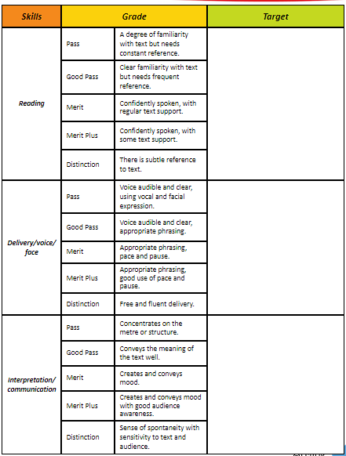
Use the self/peer assessment to judge the learners’ strengths and weaknesses in their Section 3 reading .
Notes:
Direct links to videos:
https://youtu.be/CB73g3I-TYE
https://youtu.be/-XyOJ6-leaI
If video appears as a black box, play the PPT as a slideshow and wait a few seconds for it to load.

