Slide 1

Learner Workbook Name:______________________

Slide 2


Section 1

Slide 3
Contents
Section 1 | Page
Skills Audit | 4
Generating Ideas | 5
Research Methods | 6-9
Practise your Research Skills | 10
Plan your Research | 11-13
Referencing and Plagiarism Guide | 14
Structuring your Presentation | 15
Introductions | 16
Signposting Cheat Sheet | 17
Engaging your Audience | 18
Example Presentation | 19
Skills Audit | 20

Slide 4
Skills Audit
Skill | Not Confident | Somewhat Confident | Very Confident
I can conduct thorough and pertinent research
I can draw reasoned conclusions from my research
I can structure a talk/presentation effectively
I can stick to a strict time-limit
I can use notes efficiently (not reading from the page or over-relying on them)
I can speak in a natural, confident way about a topic
I can speak audibly and clearly
I can use pace, pause and emphasis
I can use supportive material effectively
I can use eye contact and body language to engage with the audience

Slide 5
Generating Ideas
Jot down all of your initial ideas.
You could use a mind map, a list, or just write key words anywhere there is space!
Narrow this down to three ideas. Discuss them with a partner – what are the strengths and weaknesses of each? Which do you feel most passionately about? Take notes below.
Idea 1
Idea 2
Idea 3
Once you have decided on a topic, come up with a list of questions you could frame your presentation around:

Slide 6
Research Methods
Read the information about Primary and Secondary Research Methods. In your groups, list as many strengths and weaknesses for each method as you can.
Interviews
Strengths | Weaknesses
Questionnaires and Surveys
Strengths | Weaknesses

Slide 7
Research Methods
Read the information about Primary and Secondary Research Methods. In your groups, list as many strengths and weaknesses for each method as you can.
Experiments
Strengths | Weaknesses
Observations
Strengths | Weaknesses

Slide 8
Research Methods
Read the information about Primary and Secondary Research Methods. In your groups, list as many strengths and weaknesses for each method as you can.
Search Engines
Strengths | Weaknesses
Online Archives
Strengths | Weaknesses

Slide 9
Research Methods
Read the information about Primary and Secondary Research Methods. In your groups, list as many strengths and weaknesses for each method as you can.
Local and School Libraries
Strengths | Weaknesses
What will you use?
Thinking about your own presentation now – what type of research will be best for you to use?

Slide 10
Practise your research skills
Let’s take a simple research topic. How much information can you find?
Google Scholar
Other Online Archives
School/Local Libraries (or other physical resource)
Interview/Focus Group Questions
Possible Experiments/Observations
Questionnaire/Survey Questions

Slide 11
Plan your Research:
Use the table (or a blank page) to plan out how you will collect relevant qualitative and quantitative data.
Learners deliver a presentation on a researched subject of their choice. In doing so, they should use both quantitative and qualitative evidence, and present personal conclusions.
Quantitative | Qualitative
e.g. questionnaire using a Likert scale to gather data on body image | e.g. interview using open questions to gather data on women’s experiences of misogyny

Slide 12
Plan your Research
Google Scholar
Other Online Archives
School/Local Libraries (or other physical resource)
Interview/Focus Group Questions
Possible Experiments/Observations
Questionnaire/Survey Questions

Slide 13
Plan your Research

Slide 14
Referencing and Plagiarism Guide
What is plagiarism?
“Plagiarism is presenting someone else’s work or ideas as your own, with or without their consent, by incorporating it into your work without full acknowledgement.” (University of Oxford)
How do I make sure I’m not doing it?
Use paraphrasing and referencing.
Alexander (2013) strongly suggests that it would be wrong to remove talk from the study of English.
Use direct quotation and referencing.
“To remove talk from English would be both categorical nonsense (how can the study of English include reading and writing but not talk?) and pedagogical folly” (Alexander, Robin John, 2013)
Use a combination of both.
Alexander (2013) strongly suggests that it would be wrong to remove talk from the study of English, calling the idea ‘nonsense’ and ‘folly’.
Include a bibliography.
Referencing/Citing Sources:
There are two main types of referencing you can use in your presentation:
Numbering and footnotes
Parenthesis and bibliography
Useful Links and Guides:
https://guides.library.uq.edu.au/referencing/uqharvard-version-for-printing

Slide 15
Structuring your Presentation
What will my audience already understand?
What is the purpose of my talk?
What do I want my audience to come away with?
How can I capture and maintain their interest?
Introduction
Main Body
Conclusion

Slide 16
Introductions
TED Talk | Methods (hooks) | Ethos, Logos, Pathos
Andrew Solomon - depression, the secret we share
Bill Gates - the next outbreak
Jamie Oliver – teach every child about food
Suzie Sheehy – the case for curiosity-driven research
Amy Cuddy – your body language may shape who you are
Tim Urban – inside the mind of a master procrastinator
Suki Kim – undercover in North Korea
Amanda Gorman – using your voice is a political choice
Benjamin Zander – the transformative power of classical music
Beau Lotto – optical illusions show how we see

Slide 17
Signposting – Cheat Sheet
Sequencing
Basically/ Briefly,… I'd like to begin/start by ... First of all/Firstly… Then/ Next ... Finally/ Lastly ... Moving on… As I mentioned earlier…
Introducing a new point
Moving on now to … Turning to... Let’s turn now to … The next issue/topic/area I’d like to focus on … I’d like to expand/elaborate on … Now we'll move on to... I'd like now to discuss... Let's look now at...
Adding information
In addition Additionally Moreover Furthermore Further to As well as Again What is more
Analysing
Where does that lead us? Let's consider this in more detail... What does this mean for...? Why is this important? The significance of this is... It is worth noting… This corresponds to…
Referring to visuals
As you can see… As the graph shows… If you look here… We can see from the chart/map/image…
Drawing contrasts
But Contrastingly However Conversely Whereas Yet On the other hand Another angle is… An alternative perspective… Not all research agrees…
Elaborating
Above all More to the point Although Besides
Focusing the audience’s attention
As you will know… What is important here is… Most vitally… The key point is…
Highlighting opinions
It is widely believed… I think/feel/believe… It is commonly known/thought… It seems/appears that…
Useful Links
BBC Learning English
Academic English UK
Warwick University
NBED

Slide 18
Engaging Your Audience
In your pairs/groups, note down any methods you can think of to keep your audience engaged in your talk.
You might consider:
Style, use of notes, use of supportive material, voice, body language, gesture, language…
ENGAGEMENT

Slide 19
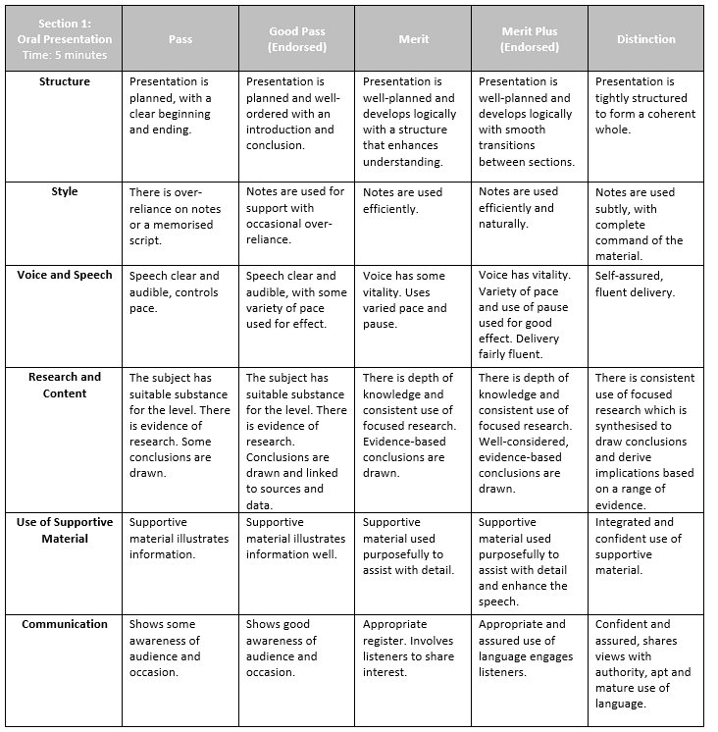
List 3 things that the learner did especially well:
What could the learner do to improve next time?

Slide 20
Skills Audit
Skill | Not Confident | Somewhat Confident | Very Confident
I can conduct thorough and pertinent research
I can draw reasoned conclusions from my research
I can structure a talk/presentation effectively
I can stick to a strict time-limit
I can use notes efficiently (not reading from the page or over-relying on them)
I can speak in a natural, confident way about a topic
I can speak audibly and clearly
I can use pace, pause and emphasis
I can use supportive material effectively
I can use eye contact and body language to engage with the audience

Slide 21
Section 2

Slide 22
Contents
Section 2 | Page
Skills Audit | 23
Types of Media | 24
How Suitable? | 25-27
Generating Ideas | 28
Introducing and Summarising | 29
Style, Bias, and Viewpoints | 30-32
A Good Discussion – Diamond 9 | 33
Causes, Effects, and Solutions | 34
Consequence Map | 35
Predicting: Questions, Opinions and Challenges | 36
Self or Peer Assessment | 37
Skills Audit | 38

Slide 23
Skills Audit
Skill | Not Confident | Somewhat Confident | Very Confident
I can keep to strict time limits
I can summarise key information succinctly
I can describe and/or analyse the style of a news item
I can identify bias
I can identify key issues and viewpoints in a piece of writing
I can speak clearly and fluently, using pause and pace for effect
I can research in order to prepare for a debate
I can effectively lead and steer a discussion/debate
I can ensure a group stays focused on the discussion
I can summarise others’ viewpoints and draw conclusions from a debate

Slide 24
Types of Media
 | Print | Internet | Broadcast
Definition
Examples
Which of these media outlets are you most familiar with?
Are there any stories you can think of that you’ve seen/read recently from any of these outlets?
What do you think makes a news piece ‘suitable’ for discussion in your ESB (International) assessment?

Slide 25
How Suitable?
SpaceX's Starship rocket starts a blaze in protected habitat surrounding Starbase during static fire test
Totally unsuitable
Probably unsuitable
Unsure
Probably suitable
Perfectly suitable
TfL security guard 'spontaneously' teams up for duet with Cambridge University music director at station
Totally unsuitable
Probably unsuitable
Unsure
Probably suitable
Perfectly suitable
Your choice of news item should:
Be of ‘substance’.
Be of suitable length and complexity to give you the opportunity to provide a full overview of the issues within a two minute window.
Allow you to explain and advocate different viewpoints.
Capture your audience’s interest and generate meaningful debate.
Give opportunities for further research.
Discuss the headlines (or full articles) together and decide how suitable they would be for your assessment.
Which would you choose from the two? Why?

Slide 26
How Suitable?
Climate change threatening buried UK treasures
Totally unsuitable
Probably unsuitable
Unsure
Probably suitable
Perfectly suitable
Taylor Swift calls out Damon Albarn over songwriting comments
Totally unsuitable
Probably unsuitable
Unsure
Probably suitable
Perfectly suitable
Your choice of news item should:
Be of ‘substance’.
Be of suitable length and complexity to give you the opportunity to provide a full overview of the issues within a two minute window.
Allow you to explain and advocate different viewpoints.
Capture your audience’s interest and generate meaningful debate.
Give opportunities for further research.
Discuss the headlines (or full articles) together and decide how suitable they would be for your assessment.
Which would you choose (if any) from the two? Why?

Slide 27
How Suitable?
I’ve seen the metaverse – and I don’t want it
Totally unsuitable
Probably unsuitable
Unsure
Probably suitable
Perfectly suitable
UN data reveals ‘nearly insurmountable’ scale of lost schooling due to Covid
Totally unsuitable
Probably unsuitable
Unsure
Probably suitable
Perfectly suitable
Your choice of news item should:
Be of ‘substance’.
Be of suitable length and complexity to give you the opportunity to provide a full overview of the issues within a two minute window.
Allow you to explain and advocate different viewpoints.
Capture your audience’s interest and generate meaningful debate.
Give opportunities for further research.
Discuss the headlines (or full articles) together and decide how suitable they would be for your assessment.
Which would you choose (if any) from the two? Why?

Slide 28
Generating Ideas
Current Events:
Big Issues:
Past events/issues of Interest:

Slide 29
Introducing and Summarising
Your News Article:
What?
Who?
Where?
When?
Key Issues?
Why was it written?

Slide 30


Style, Bias and Viewpoints
You might want to annotate the article as you go.
The Guardian, 5th January 2022
Style – Which descriptors best suit the style of this article?
Informative
Persuasive
Sensationalist
Expository
Narrative
Style – Collect examples of language to support your decisions
Quote | Language Used | Effect
Bias – Work through and discuss the following questions:
What do we know about the source? E.g. Who are they (do they have known biases?); when is the information being relayed; why are they writing?
Is there a range of viewpoints or just one?
What evidence is provided to support the claims (and what are the sources of these)?
What are other media outlets saying about the same story?
Who is the audience?
Is there any language used which reveals bias?
Based on these findings, come up with a list of discussion points or questions you could use to guide a group discussion.
Issues and Viewpoints
List 3 ‘issues’ raised by the news piece

Slide 31
Style, Bias and Viewpoints
You might want to annotate the article as you go.
The Daily Mail, 5th January 2022
Style – Which descriptors best suit the style of this article?
Informative
Persuasive
Sensationalist
Expository
Narrative
Style – Collect examples of language to support your decisions
Quote | Language Used | Effect
Bias – Work through and discuss the following questions:
What do we know about the source? E.g. Who are they (do they have known biases?); when is the information being relayed; why are they writing?
Is there a range of viewpoints or just one?
What evidence is provided to support the claims (and what are the sources of these)?
What are other media outlets saying about the same story?
Who is the audience?
Is there any language used which reveals bias?
Based on these findings, come up with a list of discussion points or questions you could use to guide a group discussion.
Issues and Viewpoints
List 3 ‘issues’ raised by the news piece

Slide 32

Style, Bias and Viewpoints
You might want to annotate the article as you go.
Now try with your own article
Style – Which descriptors best suit the style of this article?
Informative
Persuasive
Sensationalist
Expository
Narrative
Style – Collect examples of language to support your decisions
Quote | Language Used | Effect
Bias – Work through and discuss the following questions:
What do we know about the source? E.g. Who are they (do they have known biases?); when is the information being relayed; why are they writing?
Is there a range of viewpoints or just one?
What evidence is provided to support the claims (and what are the sources of these)?
What are other media outlets saying about the same story?
Who is the audience?
Is there any language used which reveals bias?
Based on these findings, come up with a list of discussion points or questions you could use to guide a group discussion.
Issues and Viewpoints
List 3 ‘issues’ raised by the news piece

Slide 33
What are the key ingredients of a ‘good’ discussion?
Most important
Least important
Being focused and on topic | Being polite | Exploring different perspectives
Having a clear leader | Everyone having a chance to speak | Speakers challenging one another’s ideas
Leader is knowledgeable and authoritative on the topic | Research has been done to support ideas | Topic is interesting and engaging

Slide 34
Causes, Effects, Solutions
CAUSES
EFFECTS
SOLUTIONS

Slide 35
Consequence Map

Slide 36
Predicting: questions, opinions and challenges
Questions
Opinions
Challenges
Research
Looking at the issues and opinions raised by your news item, try to predict the questions, opinions, and challenges that your group members might raise during your discussion.

Slide 37
Discussion Skill | Grade |  | Target
Open the discussion | Pass | Opens discussion with own views.
 | Good Pass | Develops answers from knowledge and research.
 | Merit | States discussion topic clearly, with personal viewpoint / opinions.
 | Merit Plus | Full, fluent responses extend discussion.
 | Distinction | Challenges thinking with considered ideas and opinions.
Maintain the debate | Pass | Maintains flow by asking relevant questions.
 | Good Pass | Maintains flow of discussion by asking for ideas and opinions.
 | Merit | Extends debate by ongoing analysis of responses.
 | Merit Plus | Maintains group focus. Engages well with group.
 | Distinction | Controls pace and group dynamics.
Summarise and conclude | Pass | Brief statement of views expressed during discussion.
 | Good Pass | Considered statement of views expressed during discussion.
 | Merit | Summarises debate and draws conclusions.
 | Merit Plus | Summarises debate with a considered statement of views and draws conclusions.
 | Distinction | Concise perceptive analysis, with reference to main contributions.

Slide 38
Skills Audit
Skill | Not Confident | Somewhat Confident | Very Confident
I can keep to strict time limits
I can summarise key information succinctly
I can describe and/or analyse the style of a news item
I can identify bias
I can identify key issues and viewpoints in a piece of writing
I can speak clearly and fluently, using pause and pace for effect
I can research in order to prepare for a debate
I can effectively lead and steer a discussion/debate
I can ensure the group stays focused on the discussion
I can summarise others’ viewpoints and draw conclusions from a debate

Slide 39
Section 3

Slide 40
Contents
Section 3 | Page
Skills Audit | 41
Making a Recommendation | 42-43
Evaluating your Recommendation | 44
Exploring Context | 45
Critical Approaches to Literature | 46
Strengths and Weaknesses | 47
Storyboard Template | 48
Memorisation Techniques | 49
Self or Peer Assessment | 50
Skills Audit | 51

Slide 41
Skills Audit
Skill | Not Confident | Somewhat Confident | Very Confident
I can recommend a suitable text
I can introduce a text
I can give a critical evaluation of a text
I can read aloud from a text I am familiar with
I can read aloud with minimal reference to the text
I can use pause, pace, vocality and gesture appropriately
When reading, I can convey the mood of the text
I show my awareness of the audience when I read or recite a piece of text

Slide 42
Making a Recommendation
What might we recommend to other people?
Come up with as many as you can! E.g. Books, hotels, restaurants
Think about what happens when you are making a recommendation to somebody – what do you include? What language are you using?
Come up with as many as you can! E.g. Facts, examples, supporting images

Slide 43
Making a Recommendation
Text Type | Text | Suitable? | Reasoning
Use this grid to collate your ideas and work together to assess their suitability for a ‘Literary Recommendation’.

Slide 44
Evaluating your Recommendation
Questions to consider:
What is the text about?
What are the main themes and how are they explored?
Do any of the events or characters resonate with you, personally?
How did you discover the text?
Have there been any controversies or debates around your choice?

Slide 45
Exploring Context
Historical/Social
Canonical
CONTEXTS
Cultural
Ideological

Slide 46
Critical Approaches to Literature
Feminist/Gender
Marxist
Psychoanalytical
Historical
Biographical
Reader-response
Other

Slide 47
Evaluate
Strengths
Weaknesses

Slide 48

Storyboard Template

Slide 49



Familiarisation Techniques
Method | Tried it? | Does it work for you?
Repeating each line x6
Cover up and write it out
Record and speak along
Record and listen
Storyboard

Slide 50
Skills | Grade |  | Target
Reading | Pass | A degree of familiarity with text but needs constant reference.
 | Good Pass | Clear familiarity with text but needs frequent reference.
 | Merit | Confidently spoken, with regular text support.
 | Merit Plus | Confidently spoken, with some text support.
 | Distinction | There is subtle reference to text.
Delivery/voice/ face | Pass | Voice audible and clear, using vocal and facial expression.
 | Good Pass | Voice audible and clear, appropriate phrasing.
 | Merit | Appropriate phrasing, pace and pause.
 | Merit Plus | Appropriate phrasing, good use of pace and pause.
 | Distinction | Free and fluent delivery.
Interpretation/ communication | Pass | Concentrates on the metre or structure.
 | Good Pass | Conveys the meaning of the text well.
 | Merit | Creates and conveys mood.
 | Merit Plus | Creates and conveys mood with good audience awareness.
 | Distinction | Sense of spontaneity with sensitivity to text and audience.
Notes:
Highlight the grade you feel you/your partner are working at; give a target for improvement.

Slide 51
Skills Audit
Skill | Not Confident | Somewhat Confident | Very Confident
I can recommend a suitable text
I can introduce a text
I can give a critical evaluation of a text
I can read aloud from a text I am familiar with
I can read aloud with minimal reference to the text
I can use pause, pace, vocality and gesture appropriately
When reading, I can convey the mood of the text
I show my awareness of the audience when I read or recite a piece of text

Slide 52
Section 4

Slide 53
Contents
Section 4 | Page
Skills Audit | 54
Questioning Grid | 55
Skills Audit | 56

Slide 54
Skills Audit
Skill | Not Confident | Somewhat Confident | Very Confident
I can respond to questions and challenges about my topics of choice
I can ask perceptive questions, which challenge the thinking of others
I can ask questions to further my own understanding
I can participate in a group discussion
I can offer my own ideas, and sometimes change my ideas if I need to
I can be a supportive and helpful listener
I can maintain a positive attitude throughout a group task
I can show encouragement to my peers

Slide 55
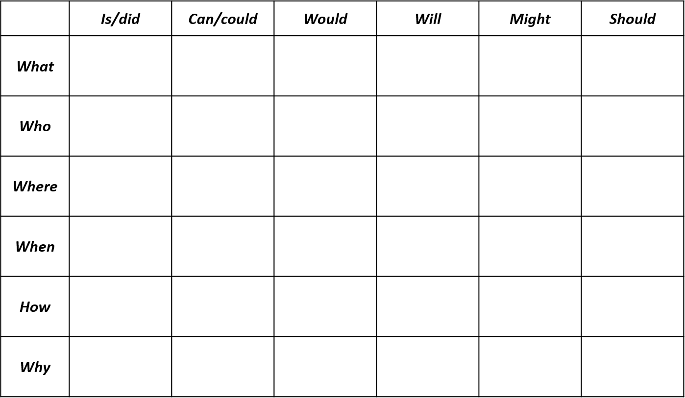
Questioning Grid

Slide 56
Skills Audit
Skill | Not Confident | Somewhat Confident | Very Confident
I can respond to questions and challenges about my topics of choice
I can ask perceptive questions, which challenge the thinking of others
I can ask questions to further my own understanding
I can participate in a group discussion
I can offer my own ideas, and sometimes change my ideas if I need to
I can be a supportive and helpful listener
I can maintain a positive attitude throughout a group task
I can show encouragement to my peers

